Slide 1
Digital image processing and analysis 6. Image enhancement: manipulating image frequencies
Professor Ela Claridge
School of Computer Science

Slide 2
Previous lecture:
Image enhancement and restoration
Image histogram
Manipulating image brightness
Contrast enhancement
LUT operations

Slide 3
In this lecture we shall find out about:
Common types of image corruption
Noise
Blur
Image frequencies
Tools and methods for noise removal
Image profile
Image filtering operations
Convolution
Low-pass (smoothing) filters

Slide 4
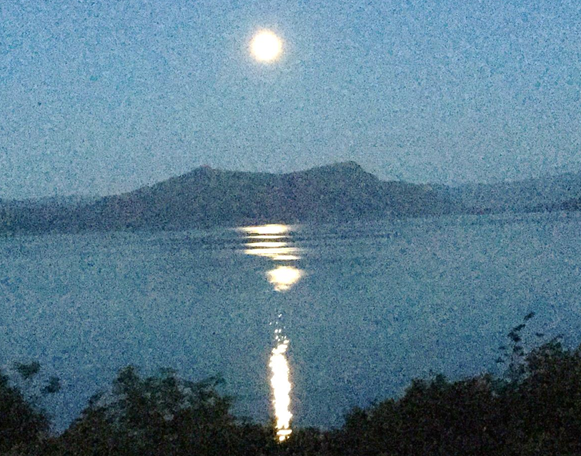
Image corruption Causes
An input digital image is never perfect, but is always “noisy” and distorted to some extent.

Slide 5
Image corruption Causes
An input digital image is never perfect, but is always “noisy” and distorted to some extent by:
Non-linearities of electronic components of sensors
Sampling and quantisation errors
Suboptimal imaging conditions
Data transmission artefacts
Sensor
Potential
well
Amplifier
ADC

Slide 6
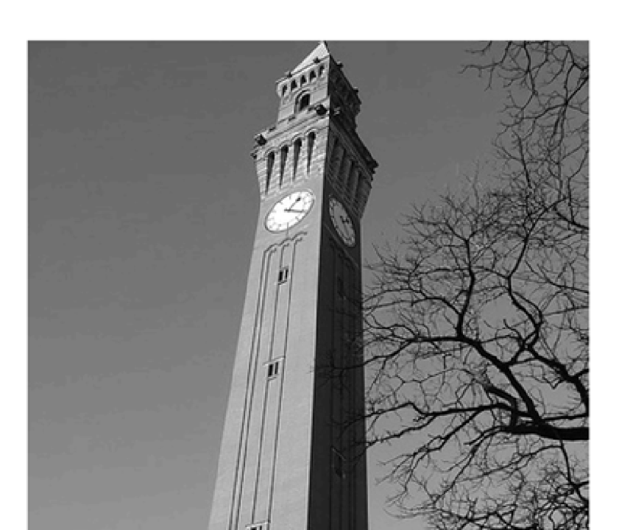


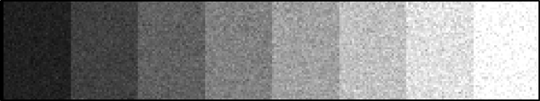
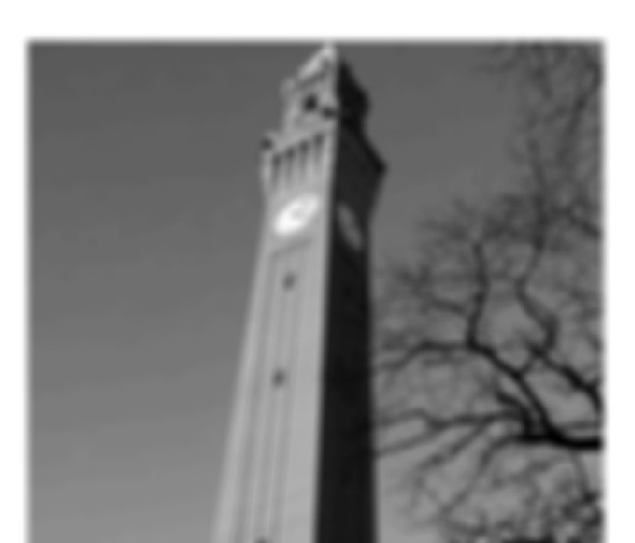

Image corruption Noise and blur
Uncorrupted image
Image corrupted by noise
Image corrupted by blur

Slide 7
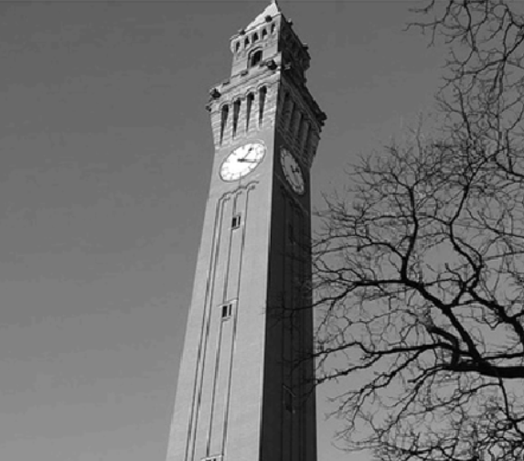
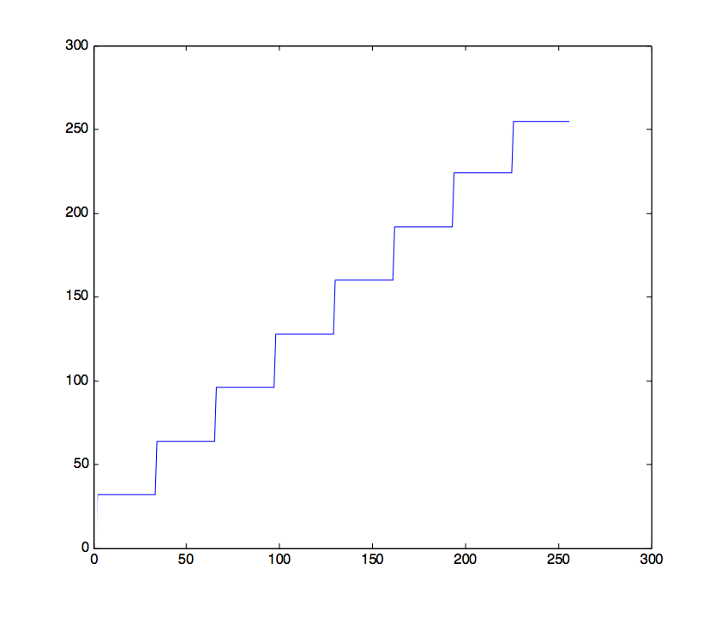
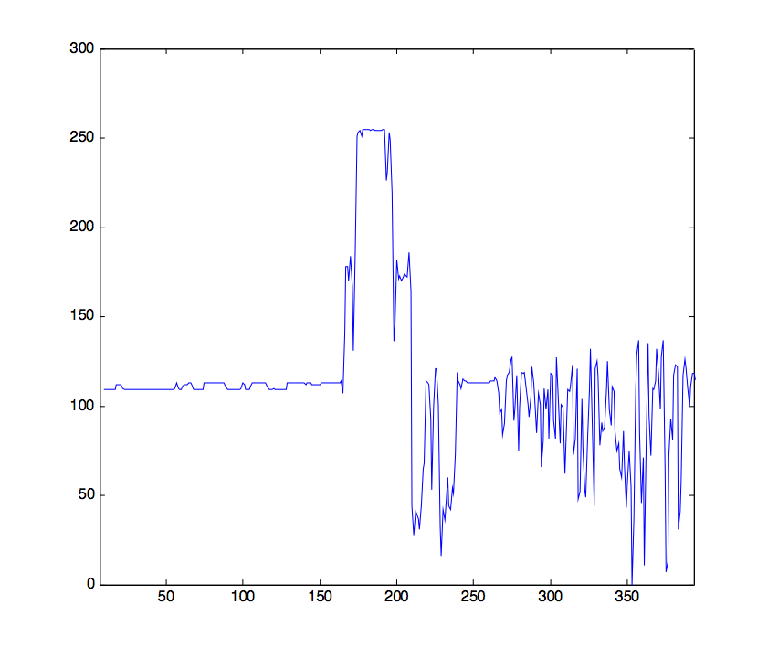
Frequency Image profile
Image profile

Slide 8
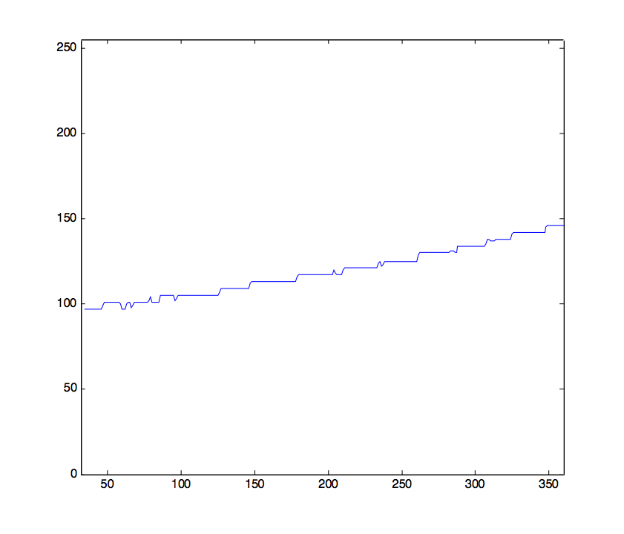
Frequency Image profile
Low frequency
High
High
Low

Slide 9
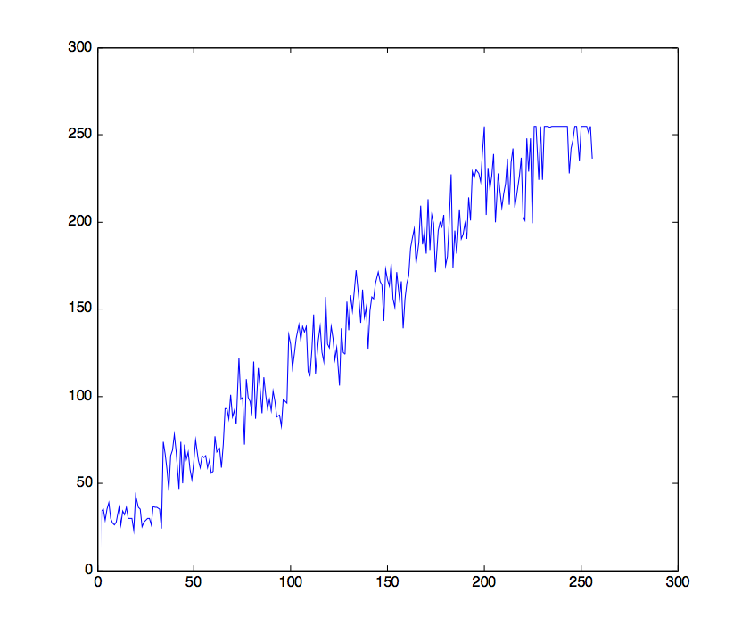
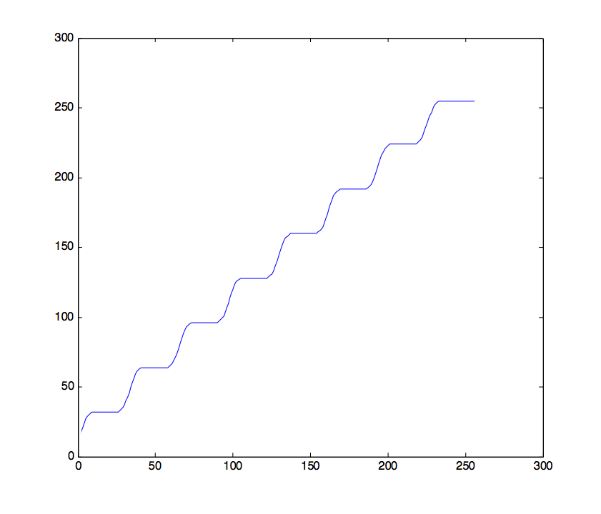
Frequency Image profile
Image profiles
Uncorrupted image
Higher frequency
Image corrupted by noise
Lower frequency
Image corrupted by blur

Slide 10

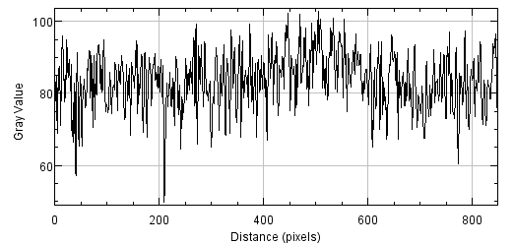
Frequency Image profile

Slide 11
Frequency filtering operations Tool for reducing frequency distortions
Frequency filtering operations separate frequency components within an image into different frequency ranges, most often into:
low frequency components
high frequency components
Following this separation
unwanted components can be rejected or,
low and high frequency components can be processed separately and then re-combined.

Slide 12
Frequency filtering operations Smoothing: low pass filter
One of the simplest methods to remove noise is to average the incoming signal over the number of sensors.
The spatial averaging produces visually smoother image; this is because the unwanted high frequencies are eliminated by averaging.
This process of smoothing works by removing rapid changes in brightness (high frequency component) but at the same time retaining slow changes (low frequency component).
Averaging of pixel values is an example of a simple digital image processing technique for reducing high frequency component of an image.

Slide 13
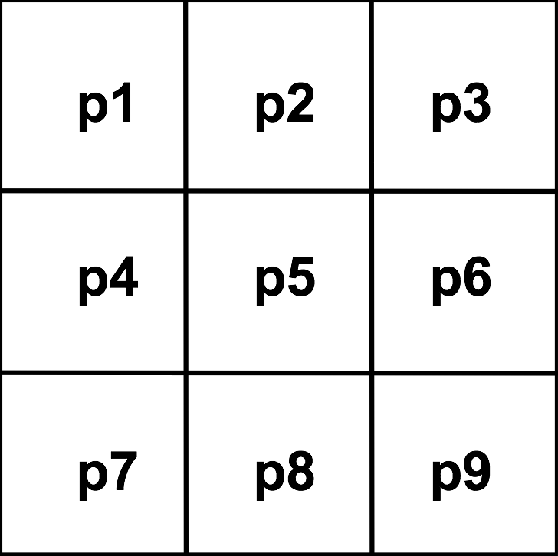
Frequency filtering operations Smoothing: low pass filter
 | New pixel value
To smooth the image, for every pixel in the original image the average pixel value is calculated for 3x3 pixel area of the image
(here pixels p1 – p9) and inserted in the position of the original pixel in a new image (here at the location of pixel p5).
new pixel value
$=\frac{1}{9}p1+\frac{1}{9}p2+$ $\frac{1}{9}p3+ \frac{1}{9}p4+ \frac{1}{9}p5+ \frac{1}{9}p6+ \frac{1}{9}p7+ \frac{1}{9}p8+ \frac{1}{9}p9$
$=\frac{1}{9}(p1+p2+$ $p3+ p4+ p5+ p6+ p7+ p8+ p9)$

Slide 14
Frequency filtering operations Smoothing: low pass filter
p1 | p2 | p3
p4 | p5 | p6
p7 | p8 | p9
This is equivalent to multiplying pixel values p1 - p9 by values stored in a small 3x3 matrix called a convolution kernel (or a convolution mask or a filter).
A convolution kernel can also be thought of as a set of spatial weights applied to an input signal.
1/9 | 1/9 | 1/9
1/9 | 1/9 | 1/9
1/9 | 1/9 | 1/9
new pixel value
$=\frac{1}{9}p1+\frac{1}{9}p2+$ $\frac{1}{9}p3+ \frac{1}{9}p4+ \frac{1}{9}p5+ \frac{1}{9}p6+ \frac{1}{9}p7+ \frac{1}{9}p8+ \frac{1}{9}p9$

Slide 15
Frequency filtering operations Convolution
Convolution kernel
Active pixel
Input image
Resulting output image

Slide 16
Frequency filtering operations Convolution

Slide 17
Frequency filtering operations Convolution

Slide 18
Frequency filtering operations Convolution

Slide 19
Frequency filtering operations Convolution
Convolution is a very important image processing operation. It is an example of a so-called linear transformation because the only operations necessary are that of addition and multiplication.
Depending on the weights in the kernel, many different image processing operations can be carried out using convolution.

Slide 20
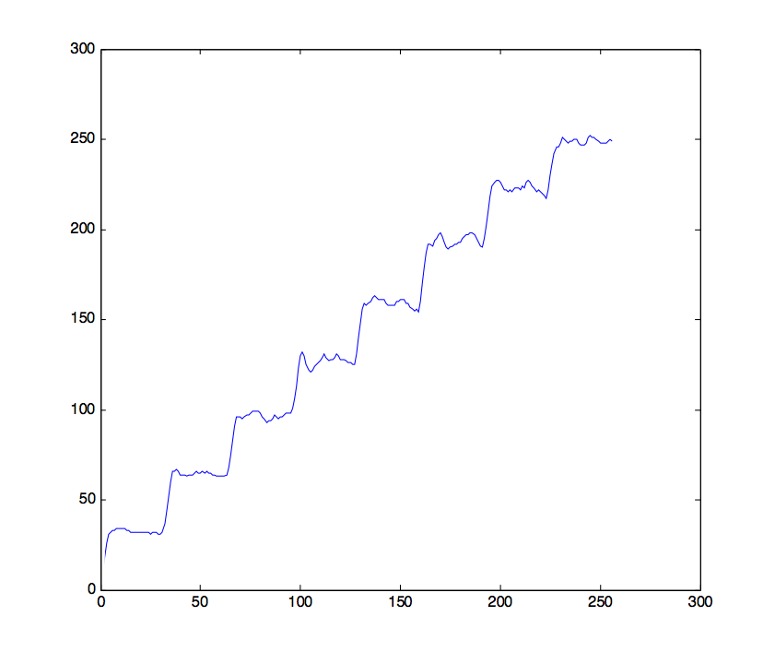
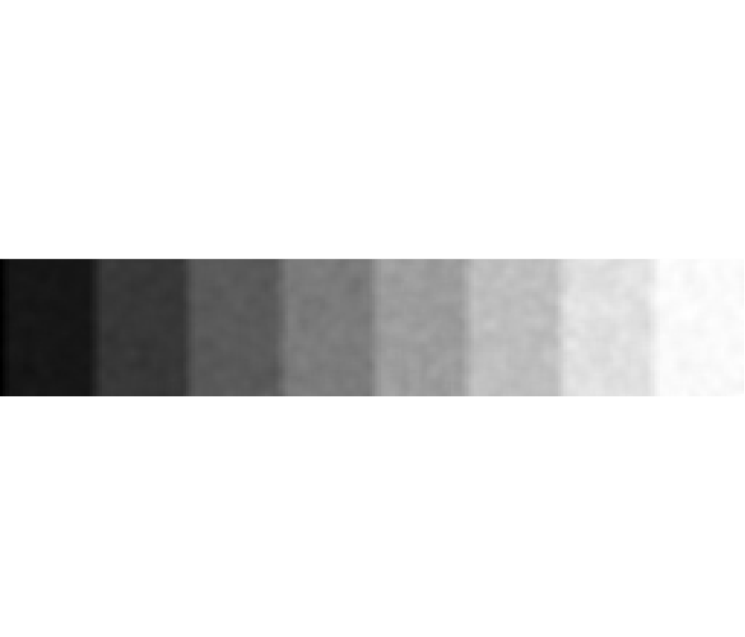
Frequency filtering operations Low-pass filters
Low pass filters remove high frequency components and pass through low frequency components. Most low frequency filters suffer from the side effect: blur.
Uncorrupted image
Image corrupted by noise
Image restored by low-pass filtering

Slide 21
Frequency filtering operations Low-pass filters
Examples of low pass filters
1/9 | 1/9 | 1/9
1/9 | 1/9 | 1/9
1/9 | 1/9 | 1/9
1/10 | 1/10 | 1/10
1/10 | 1/5 | 1/10
1/10 | 1/10 | 1/10
1/16 | 1/8 | 1/16
1/8 | 1/4 | 1/8
1/16 | 1/8 | 1/16
Can you deduce the principles?

Slide 22
Frequency filtering operations Low-pass filters
Can you deduce the principles?
k₁ | k₂ | k₃
k₄ | k₅ | k₆
k₇ | k₈ | k₉
k₁+k₂+ … +k₉ = 1
0 ≤ k_{i} < 1
k_{centre} ≥ remaining k_{i}

Slide 23
Frequency filtering operations Low-pass filters
Examples of low pass filters (again)
1/9 | 1/9 | 1/9
1/9 | 1/9 | 1/9
1/9 | 1/9 | 1/9
1/10 | 1/10 | 1/10
1/10 | 1/5 | 1/10
1/10 | 1/10 | 1/10
1/16 | 1/8 | 1/16
1/8 | 1/4 | 1/8
1/16 | 1/8 | 1/16

Slide 24
Frequency filtering operations Low-pass filters
Can you deduce the principles?
Intuitive hints
If all pixels in a small image region have the same value, the result of convolution is that constant value.
The same image values => frequency 0 (lowest), so “passed through” a low-pass filter
If pixel values in a small image region change rapidly, the result of convolution is the average value over the region.
High frequencies “removed”, only low frequency “base” value passed through.
k₁ | k₂ | k₃
k₄ | k₅ | k₆
k₇ | k₈ | k₉

Slide 25
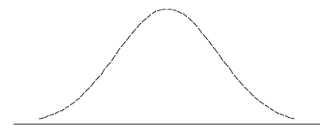
Frequency filtering operations Low-pass filters
1/16 | 1/8 | 1/16
1/8 | 1/4 | 1/8
1/16 | 1/8 | 1/16
A typical profile of a low-pass filter

Slide 26
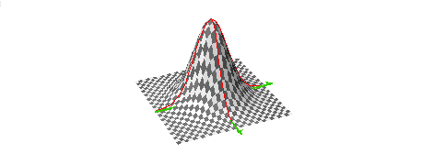
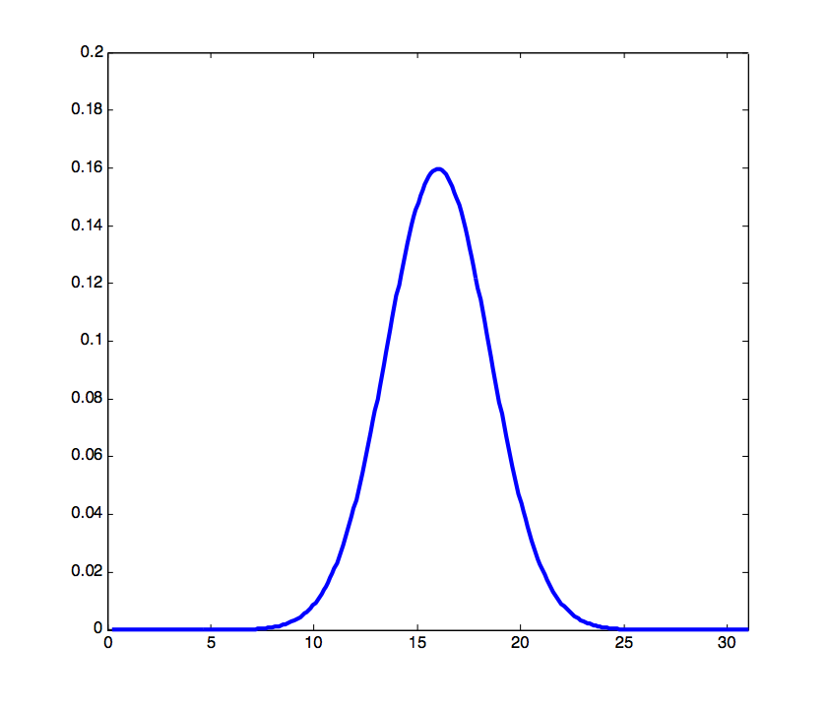
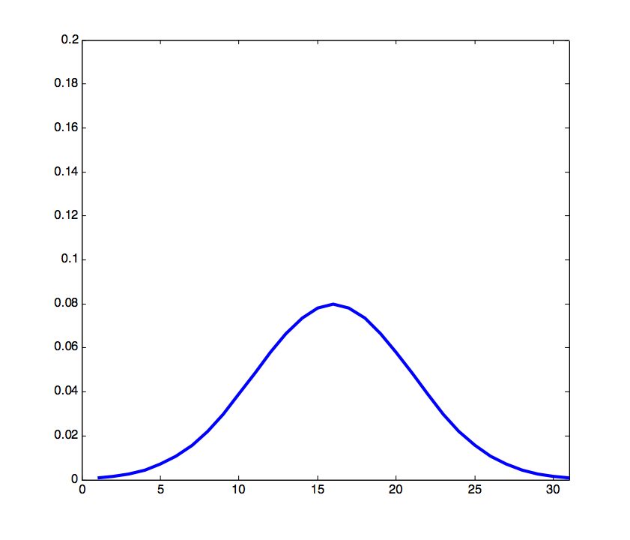
Frequency filtering operations Low-pass filters: Gaussian smoothing
σ = 2.5
σ = 5
A two-dimensional Gaussian function makes a flexible smoothing kernel. The formula is:
The amount of smoothing depends on the value of σ:
the greater the σ the stronger the effect of smoothing.

Slide 27
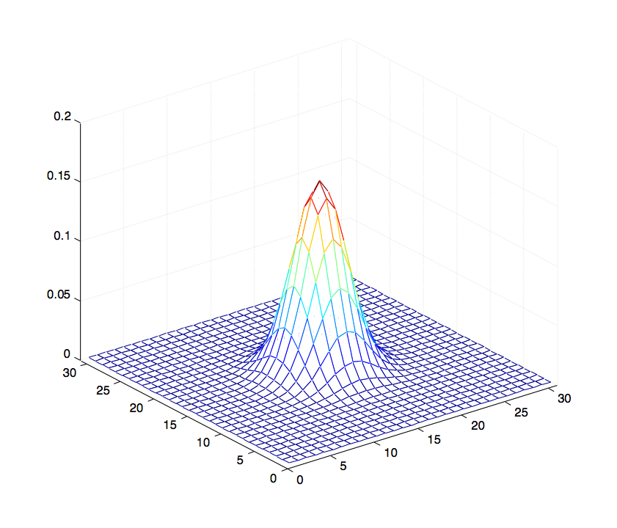
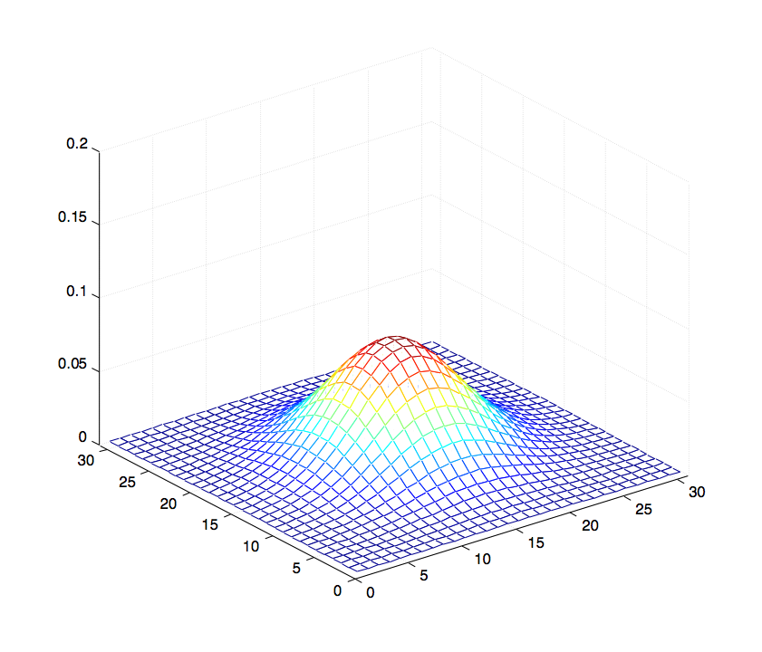
Frequency filtering operations Low-pass filters: Gaussian smoothing
σ = 2.5
σ = 5.0

Slide 28

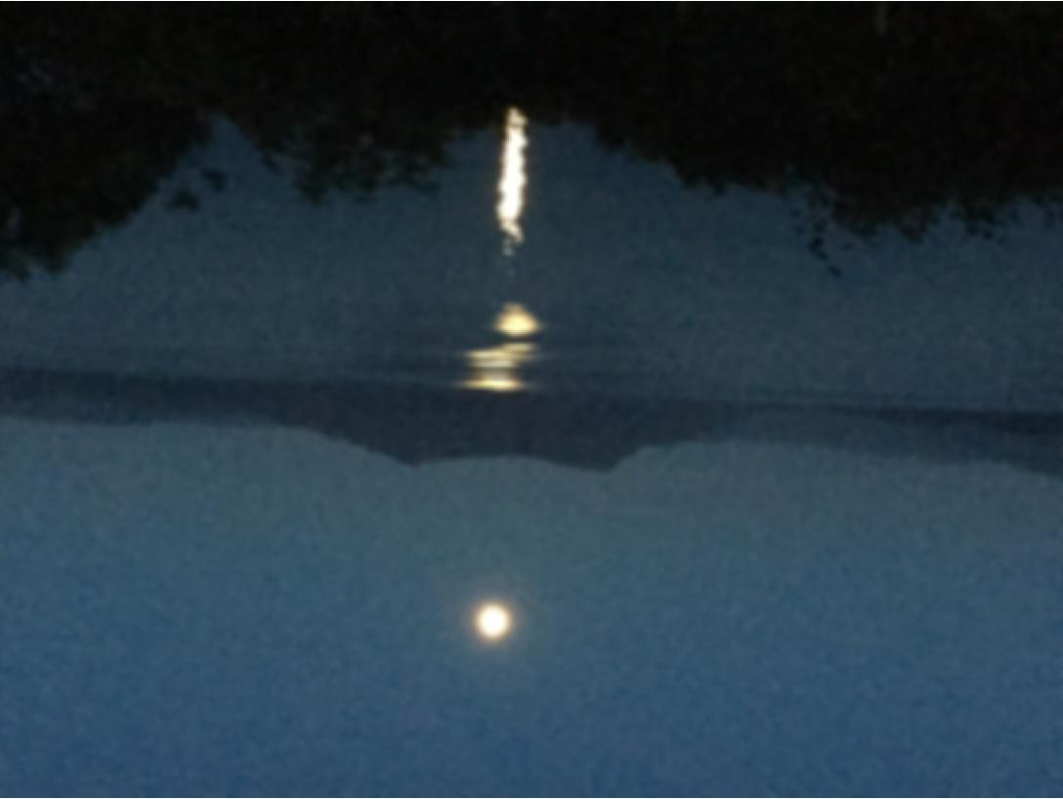
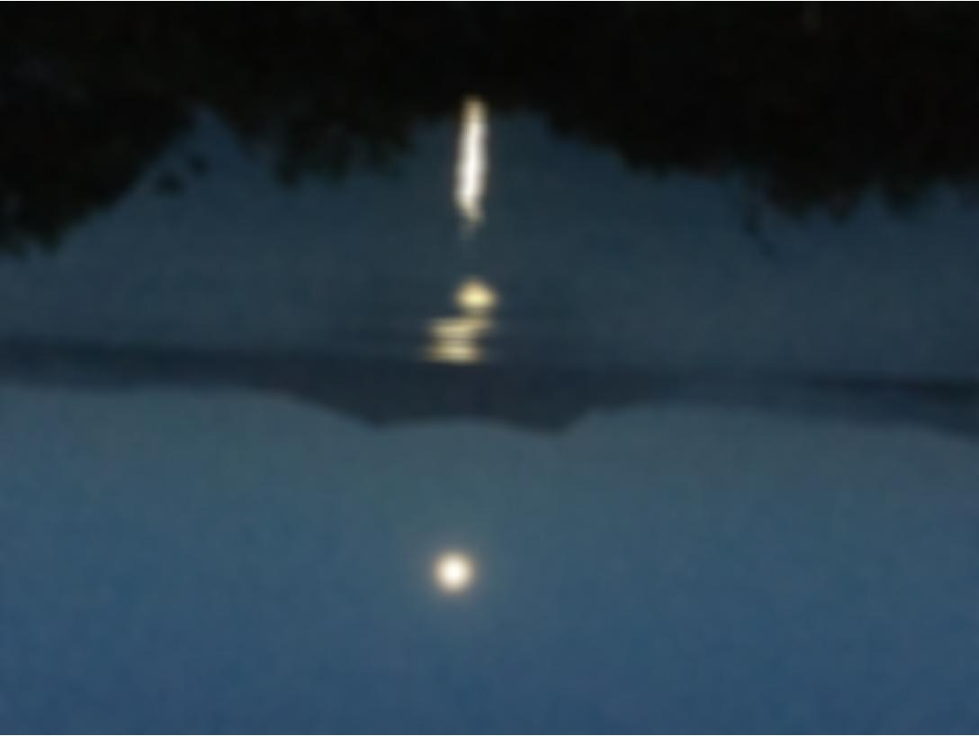
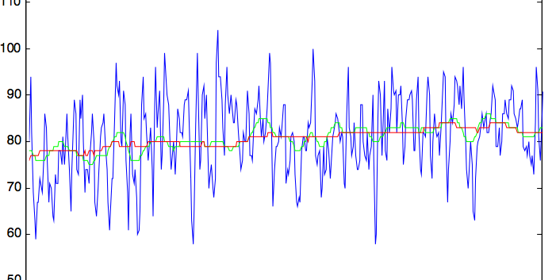
Effects of Gaussian smoothing
σ = 2.5
σ = 5.0

Slide 29
Frequency filtering operations Low-pass filters
Applications
Removing visual "noise" present in an image
Smoothing - removing high frequency components to examine low frequency ones
Side effect: blur

Slide 30
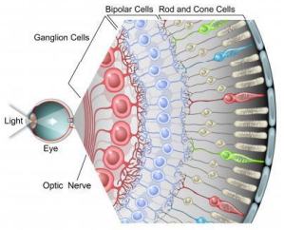
Frequency filtering operations Low-pass filters in nature
Horizontal cells
Bipolar cells
Ganglion cells

Slide 31
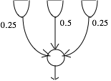
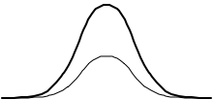
Frequency filtering operations Low-pass filters in nature
Horizontal cells
Integrate and regulate the input from multiple photoreceptor cells
Retinal receptors
Weights
Horizontal cell
Effect: weighted averaging of inputs

Slide 32
In this lecture we have covered:
Common types of image corruption
Noise
Blur
Image frequencies
Tools and methods for noise removal
Image profile
Image filtering operations
Convolution
Low-pass (smoothing) filters

Slide 33
Next lecture:
Causes of image blur
Combining frequencies for image sharpening
Digital filtering for image sharpening
Sharpening filters
High-pass filters
How human visual system sharpens images

Slide 34
Further reading and experimentation
Book chapters:
Sonka, M. Hlavac, V. Boyle, R. Image Processing, Analysis and Machine Vision, Chapman & Hall Computing (various editions), 4.3.1.
Gonzalez, R.C. & Woods, R.E. Digital Image Processing, Addison-Wesley (various editions), 4.2.4, 4.3.2.
Umbaugh, S.E. Computer vision and image processing : a practical approach using CVIPtools , Prentice Hall International (various editions), 3.2, 4.1, 4.2, 4.4.
Image noise: https://photographylife.com/photo-noise-reduction-tutorial
HIPR2 resources
Mean (average) filter: http://homepages.inf.ed.ac.uk/rbf/HIPR2/mean.htm
Gaussian smoothing http://homepages.inf.ed.ac.uk/rbf/HIPR2/gsmooth.htm

